Slide 1


Entity Extraction with 10-Ks:
It’s Complicated
Notes:
Hi everyone. My name is Ali Bridgers. This started for me as a practical question: in a world with AI, machine learning, LLMS!, why does entity extraction from SEC filings still feel harder than it should?
On paper, 10-Ks are structured documents. In practice, they’re anything but. And that gap between expectation and reality is what this work is really about.

Slide 2
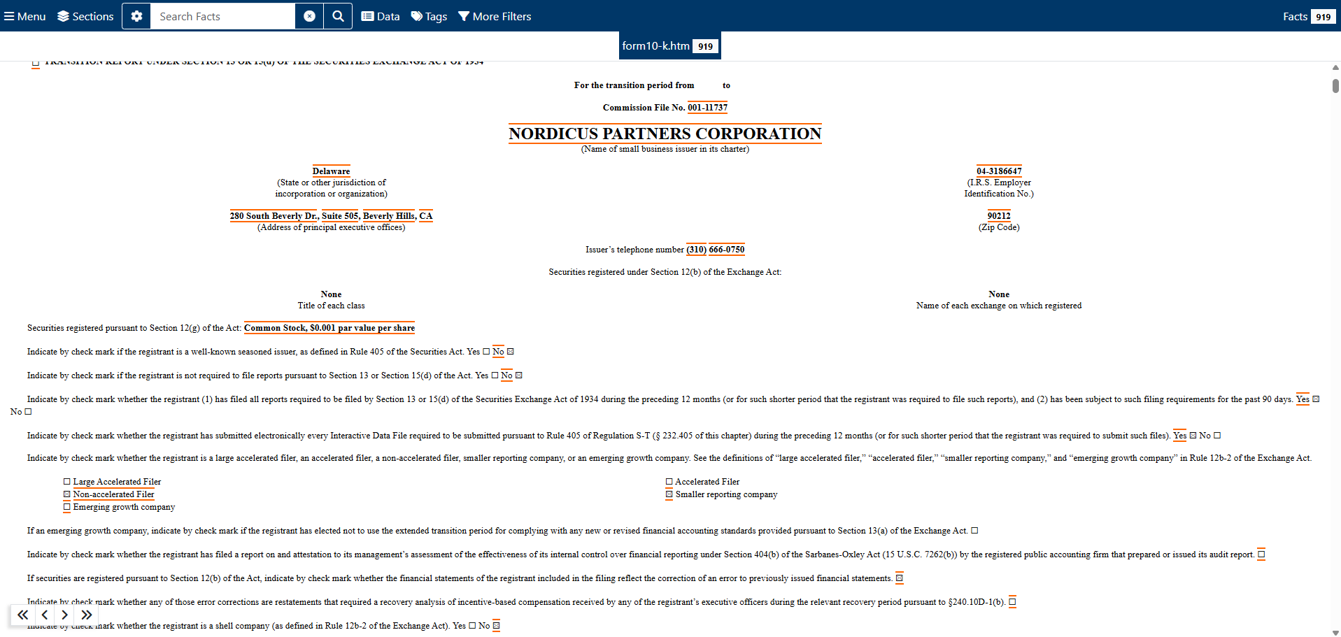
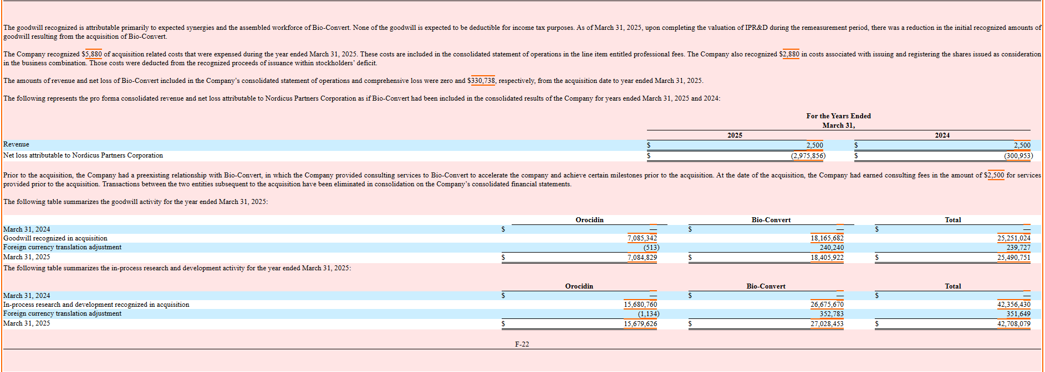
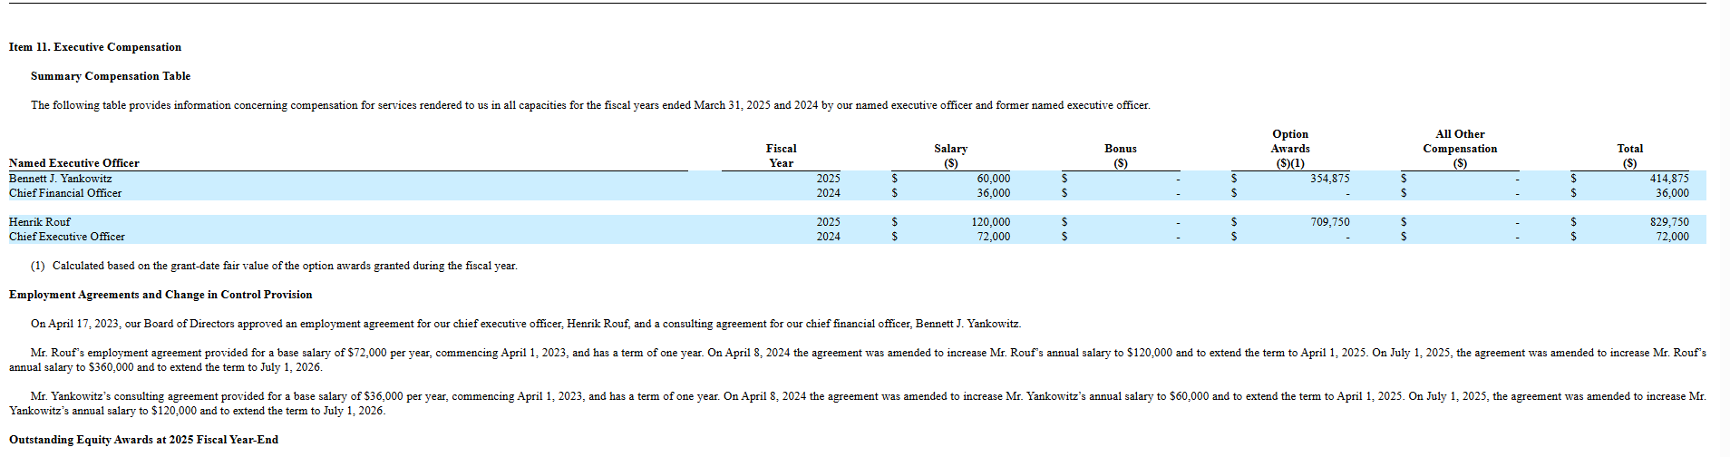
10-Ks in the Wild
Dense narrative sections broken up by tables and footnotes
Structure is implied, not consistently encoded
Humans can adapt; automated systems must guess
Notes:
If you pull up a live SEC Form 10-K directly from the SEC website, this is what you’re dealing with.
You’ve got long blocks of narrative text mixed with tables, footnotes, and cross-references. Formatting isn’t consistent across companies, and it’s often not even consistent within the same document. Fonts are tiny. Tables break up the text. Important information might be split across sections or pushed off into a referenced proxy statement.
All three of these screenshots are from the same filing. To a human reader, the structure is still understandable — but it isn’t explicitly encoded anywhere. This is what I mean by implied structure.
From an extraction standpoint, this is difficult input. Even for a human analyst, it’s slow and fatiguing to work through. For machines, it’s worse.
A lot of people assume OCR is the main challenge here, but most modern 10-Ks are born-digital, not scanned paper documents. The text is there — the problem is that the structure isn’t. Tables, lists, and boundaries that make sense to a human reader aren’t reliably machine-readable, and a lot of context is implied rather than explicit.
Unless you’re literally highlighting content in PDFs — and that’s only if the PDF is cleanly extractable — automated systems are left trying to infer structure from weak and inconsistent signals.
This matters because many extraction approaches assume much cleaner inputs than this.

Slide 3
Scoping the Problem
SEC 10-K filings contain key business entities embedded in narrative text
Manual extraction is slow and inconsistent across filings
The goal is to extract a reliable subset of entities from this structure
Notes:
Given what we just saw, the problem isn’t that these documents lack information. It’s that the information we care about is embedded in narrative text that only looks structured.
SEC 10-K filings contain a lot of key business entities — names, roles, organizations, financial values — but they’re buried in long-form narrative sections with implied structure. Humans can adapt to that pretty quickly. We skim, we contextualize, we fill in gaps.
Manual extraction works, but it’s slow, it’s tedious, and it’s inconsistent. Two people reviewing the same filing may not extract the same things, or may extract them in different ways, especially when formatting or phrasing changes.
So the problem I focused on here wasn’t “extract everything,” and it wasn’t “fix the documents.”
It was whether a specific subset of business entities could be extracted from this kind of narrative structure in a way that’s more consistent and less time-intensive than manual review.

Slide 4

Data Selection
SEC Form 10-K filings (Kaggle JSON dataset)
Narrative sections pre-extracted and segmented
No OCR, PDF parsing, or HTML cleanup
Known gaps (e.g., proxy statement references)
Notes:
Given that framing, data selection mattered a lot.
I wasn’t looking for a perfect dataset — I was looking for something that let me focus on the extraction problem itself without getting bogged down in upstream issues.
For this project, I used a publicly available Kaggle dataset of SEC Form 10-K filings provided as structured JSON. The biggest advantage here is that the narrative sections are already extracted and segmented. There’s no OCR, no PDF parsing, and no HTML cleanup, which allowed me to work directly with the text instead of spending time reconstructing it.
That said, the dataset isn’t perfect. Some filings reference proxy statements instead of including executive information directly, which means certain sections — especially Item 10 — may be missing or incomplete. I kept those cases intentionally, because that’s a real constraint analysts have to deal with.
Overall, this dataset struck a useful balance: clean enough for controlled experimentation, but realistic enough to surface downstream challenges.

Slide 5
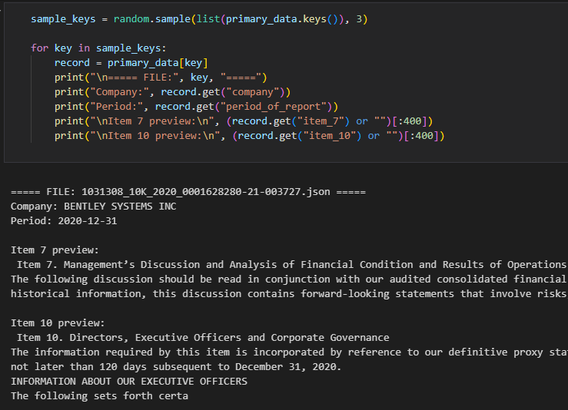
Data Preparation & Scoping
Filtered filings to narrative sections of interest
Scoped analysis to Item 7 and Item 10
Normalized text for consistent processing
Preserved document-level context for evaluation
Notes:
With the data selected, the next step was getting it into a form that could actually be evaluated.
There isn’t a lot of traditional “cleaning” here in the sense of correcting text. Most of the work is about scoping and normalization.
I filtered the filings down to the narrative sections I cared about — primarily Item 7 and Item 10 — and normalized things like whitespace and section boundaries, without trying to overcorrect formatting quirks that a real system would still have to handle.
I also preserved document-level context so extraction results could be evaluated at the section level rather than as isolated snippets.
The goal here wasn’t perfection — it was consistency, so different extraction approaches could be compared fairly.

Slide 6
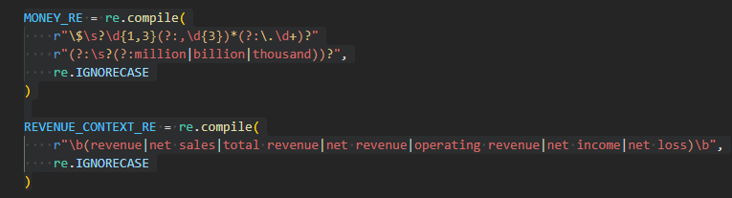
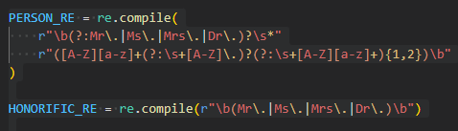
Establishing a Baseline
Rule-based extraction using regular expressions
Targeted a scoped set of business entities
Designed for transparency and repeatability
Serves as a performance baseline for comparison
Notes:
With the data prepared, the next step was establishing a baseline.
I started with a rule-based approach using regular expressions, because it’s the most code-native way to extract text without introducing a model.
The rules target the same scoped set of business entities used throughout the project. They’re explicit and repeatable — if something is extracted, you can point directly to the rule responsible.
You’re not meant to read this code. What you’re seeing is just a small slice of the logic. A lot of the work lives in exclusion lists and guardrails — things like organization-like tokens, role words, certification phrases, and blocklists designed to prevent false positives.
That scaffolding matters, because without it, regex extraction will happily match things that technically fit a pattern but aren’t meaningful entities.
Even with that effort, this approach has clear limits — which is exactly why it works as a baseline.

Slide 7
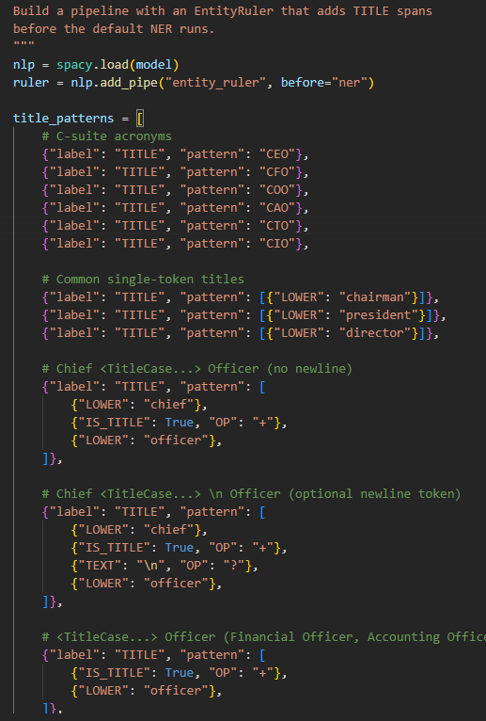
Guided Named Entity Recognition
Supervised Named Entity Recognition using spaCy
Trained on manually labeled 10-K narrative sections
Scoped to the same business entities as the baseline
Designed to incorporate domain-specific signals
Notes:
From there, I moved to a supervised Named Entity Recognition approach using spaCy.
The model was trained on manually labeled 10-K narrative sections using the same entity definitions and scope as the baseline. Nothing about the problem itself changed.
What did change is how domain knowledge was incorporated. I augmented the pipeline with an EntityRuler that runs before the default NER component.
Those rules add domain-specific signals — like executive title patterns — deterministically. The resulting spans are then passed downstream to the model.
This allows the model to start from a more informed representation of the text instead of inferring everything from scratch. It’s a way of combining structured rules with learned behavior.
The goal here isn’t to replace rules with machine learning — it’s to use domain knowledge to guide the model toward more consistent extraction.

Slide 8
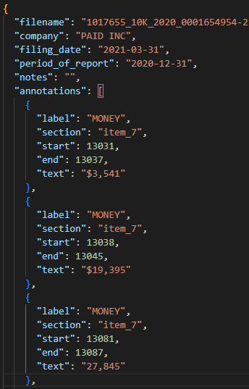
Evaluation & Gold Set
Created a manually annotated gold set
Scoped to Item 7 and Item 10 sections
Used consistent entity definitions across approaches
Evaluated precision, recall, and F1 score
Notes:
To evaluate both approaches, I needed a reference point — a manually annotated gold set.
The gold set was scoped to Item 7 and Item 10, using consistent entity definitions across both extraction approaches. The goal wasn’t scale; it was consistency.
That gave me a stable basis for comparison, where differences in performance could be attributed to the extraction method rather than changes in labeling criteria.
On the left is an example of the annotation format. Each entity includes a span, section, and type, allowing evaluation at the section level.
Using this gold set, I evaluated both approaches using precision, recall, and F1 score to measure accuracy and consistency.

Slide 9
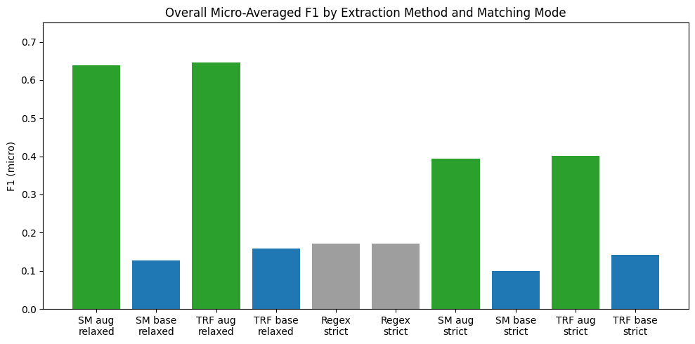
results
Notes:
Along the x-axis, you’re seeing the regex baseline, a base spaCy model, and an augmented spaCy model, evaluated under strict and relaxed matching.
The regex baseline only appears under strict matching, because regex extraction is inherently exact — there isn’t a meaningful relaxed equivalent.
For the machine learning models, strict matching requires exact span alignment, while relaxed matching allows partial overlap. That’s especially useful for narrative text where entity boundaries aren’t always consistent.
What stands out is the clear separation between unaugmented and augmented models. Across both spaCy variants, adding domain-specific rules before NER substantially improves performance — especially under relaxed matching.
What’s important here isn’t that any single model wins. It’s that once domain knowledge is introduced in a structured way, performance improves consistently across models and evaluation modes.
That suggests the real leverage in this problem isn’t model complexity — it’s alignment with the domain.

Slide 10

Key Takeaways & Implications
Domain knowledge materially improves extraction performance
• Off-the-shelf models struggle with implied structure
• Augmented pipelines outperform regex and baseline ML
• Best results come from combining rules with learning
Notes:
To wrap this up, I want to zoom out from the individual scores.
Entity extraction from SEC filings isn’t failing because the data is unavailable, and it isn’t failing because the models aren’t powerful enough. It fails when too much domain knowledge is left implicit.
The regex baseline offered transparency but didn’t scale well. The unaugmented ML models struggled because they were being asked to infer structure that isn’t explicit in the text.
The strongest results came from combining those approaches — using domain-specific rules to guide the model rather than replace it.
That suggests the most effective solution here isn’t purely rule-based or purely machine learning. It’s a hybrid approach that treats domain knowledge as a first-class input.
More broadly, this reinforces that for problems like this, success depends less on model size and more on alignment with the structure — and messiness — of real documents.
That’s ultimately what this project set out to explore.
Thank you.

